Slide 1

Putting It All Together with xLights
Matt Brown
(dowdybrown on DIYLA & DIYC)

Slide 2
Purpose Of This Class
Learn the capabilities of xLights
Learn how to install and configure xLights
Learn how to apply the capabilities of xLights to your Show

Slide 3
xLights Capabilities
Show scheduler
Tester
Sequence Converter

Slide 4
Benefits
Support for a wide variety of lighting controllers and networks
Reliable, flexible scheduling. Playlists can be scripted to run in any order and can respond to input from external sources.
Robust testing module for both traditional and RGB lights, including Smart Strings
Runs on Windows, Mac, and Linux

Slide 5
USB Driver
If you are using any type of USB dongle, ensure you have the FTDI VCP drivers installed.
If you have successfully used an LOR or Lynx dongle on your system, you already have the right driver installed.
This step is only required for Windows and Mac systems. FTDI drivers are already built in to most Linux distributions.
Drivers can be found here: http://www.ftdichip.com/FTDrivers.htm

Slide 6
Downloading xLights
Ready to run versions of xLights for Windows and Mac can be downloaded from SourceForge:
  http://sourceforge.net/projects/xlights/files/
After downloading, just double-click on the file
Linux users need to compile xLights. Instructions are here:
  http://xlights.svn.sourceforge.net/viewvc/xlights/trunk/ToolConfig.txt?view=markup

Slide 7
Show Directory
xLights expects you to organize all of your sequence files and associated audio or video files into a single directory.
You can have a directory called "TestSequences" with some sequences you are testing.
For your 2012 show, you can have a directory called "2012 Show".
Don't bother starting xLights until you have this directory created. But once you do, fire up xLights (xMenu module).

Slide 8
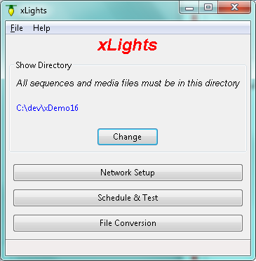
Main Menu (xMenu)
Currently selected show directory
Change show directory
Define your lighting networks
Define schedule, run schedule, and test lights
Convert sequences from one format to another

Slide 9
Lighting Networks
The next thing you will need to do is define your lighting network(s).
xLights ignores most of the information about your lighting network contained in your LOR or Vixen sequence. Thus this step is very important.

Slide 10
Lighting Networks
Click on the "Network Setup" button to bring up the network definition grid.
Add a row for each network or universe used in your display.
If you have 1 USB dongle, then you just need one row in your table.
if you have a larger display with more than one network, xLights can drive a mixture of network types (DMX, LOR, Renard, Pixelnet, and E1.31 can be intermixed).

Slide 11
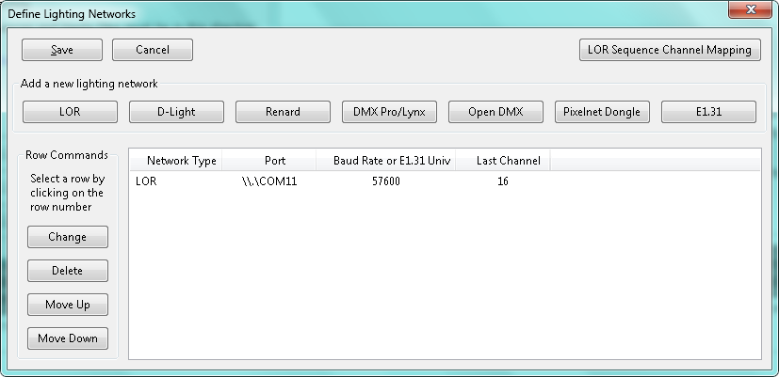
Lighting Networks

Slide 12
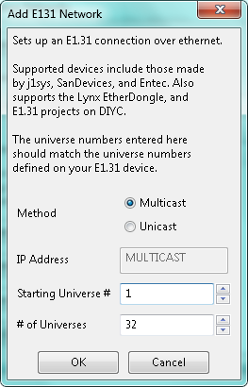
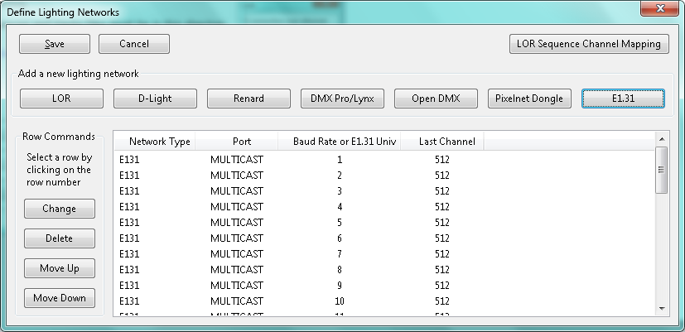
Lighting Networks - EtherDongle

Slide 13
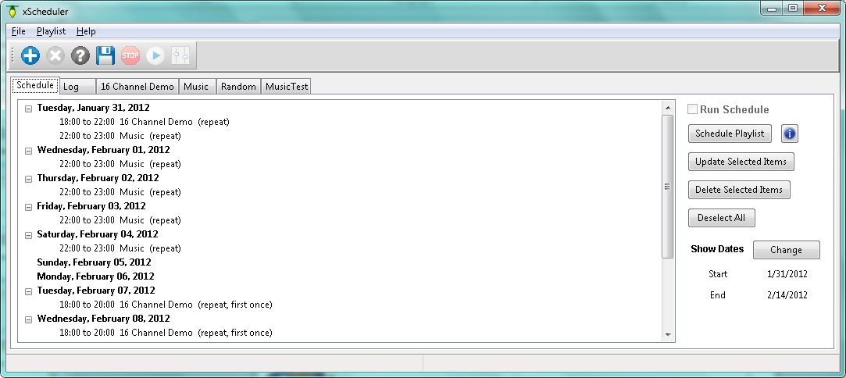
xScheduler
Create Playlist(s)
Create schedule
run schedule
Or…
test lights

Slide 14
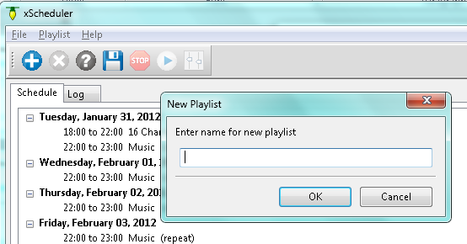
Create Playlist
#1: Click “+” button to add a new playlist
#4: Your new playlist will be added as a new tab
#3: Click OK
#2: Enter the name for your new playlist

Slide 15
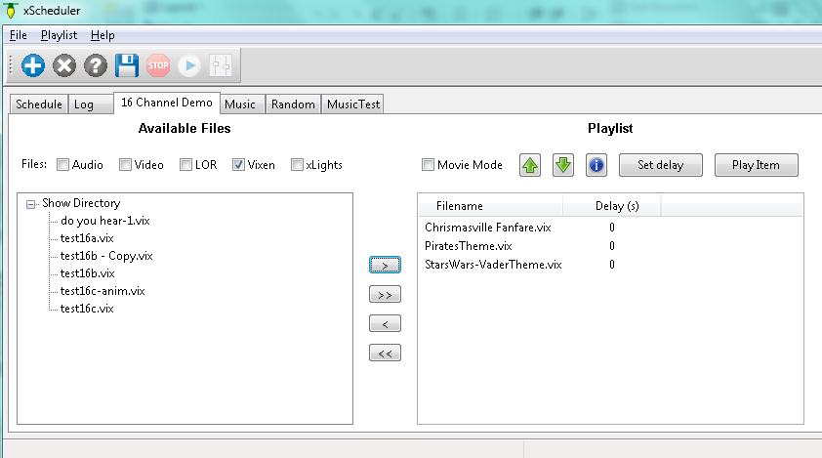
Configure Playlist
#1: Click the checkbox for the type of files you want included in your playlist
#2: Select a file name in the box on the left, then click the “>” button to move it into the playlist. Repeat as necessary.
#4: Click Save icon
#3: Adjust playlist order by clicking on a file name then clicking the up or down buttons

Slide 16
Other Playlist Options
Delete the current playlist
If you sequence to movies instead of music, selecting “Movie Mode” for playback will show the movies full screen.
Get help
See how sequence channels are mapped to physical channels
Add all items to playlist
Remove item from playlist
Play the selected item in the playlist
Remove all items from playlist
Set a delay after the item plays by selecting the item, then click the “Set Delay” button

Slide 17
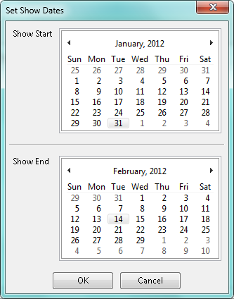
Create Schedule
First thing to do is set the show’s start and end dates

Slide 18
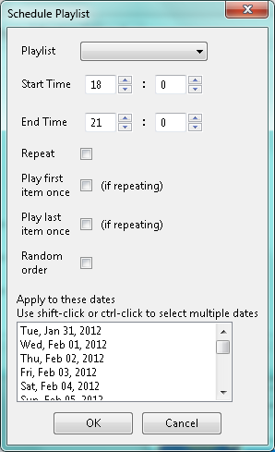
Create Schedule
Once dates are set, one or more playlists can be scheduled each day

Slide 19
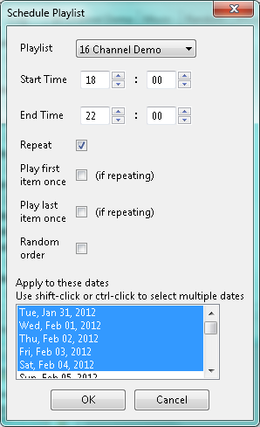
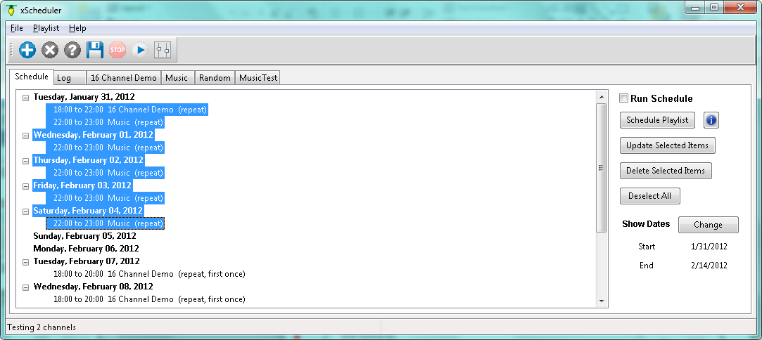
Update Schedule
Mass updates to the schedule are possible by selecting multiple playlists using Ctrl-Click or Shift-Click, then selecting Update or Delete selected items. Selected date headings are ignored.

Slide 20
Run Schedule
The schedule will only run when the “Run Schedule” checkbox is checked. The state of this checkbox is remembered between program invocations.

Slide 21
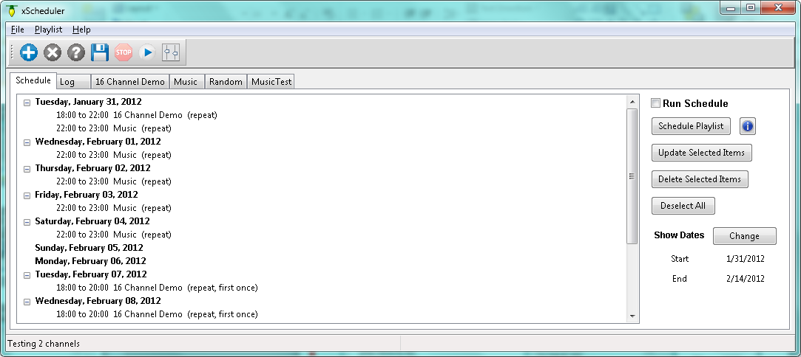
Testing Your Lights
Enter the testing module by clicking on the Test icon on the toolbar.

Slide 22
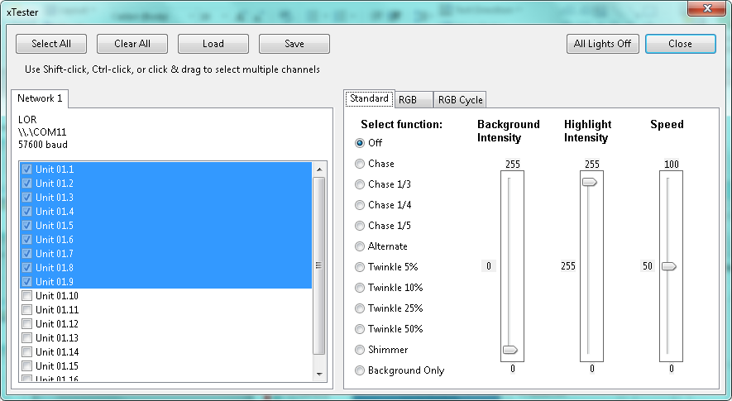
Standard Tests
When finished testing, turn all lights off, then click close
Select multiple channels by using shift-click or Ctrl-click. Then click the checkbox of any of the selected channels to activate all selections.

Slide 23
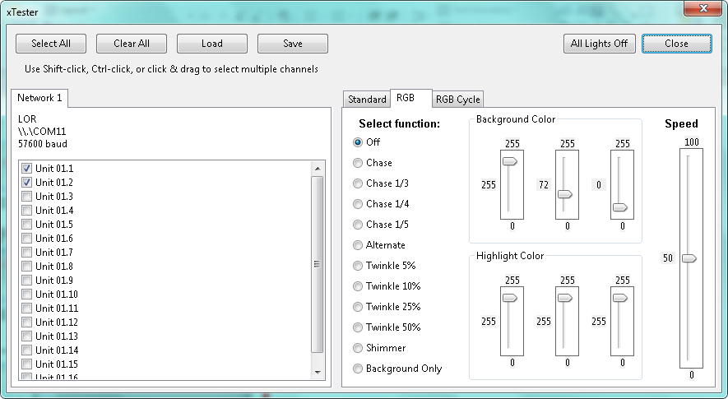
RGB Tests
These tests treat lights in groups of 3.

Slide 24
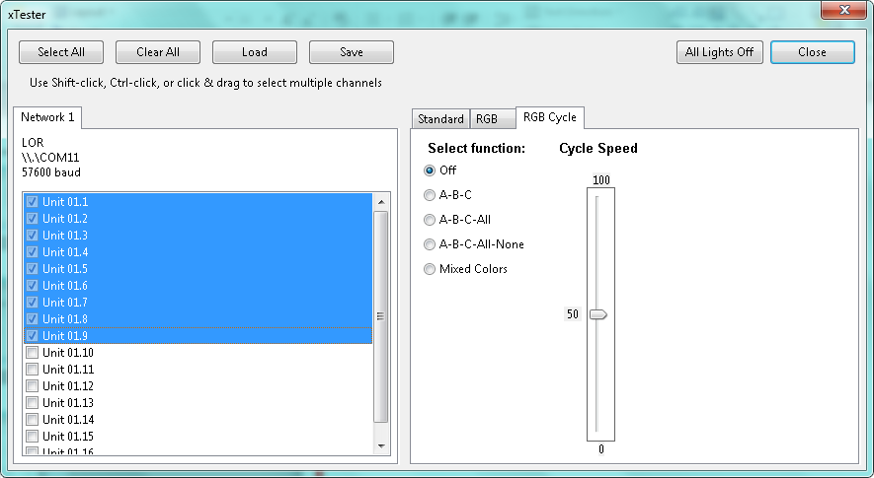
RGB Cycle Tests
These tests treat lights in groups of 3. Every group of 3 gets the same color.

Slide 25
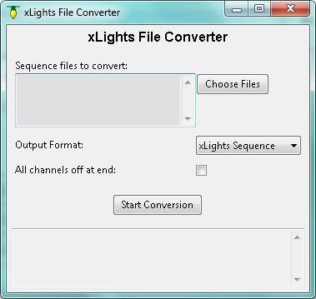
xConverter
Convert sequences from one format to another

Slide 26
xConverter Formats
Input | Outpus
 | xLights Format (.XSEQ) | Lynx Conductor (.SEQ) | Vixen 2.1 (.VIX)
LOR Music (.LMS) |  |  | 
LOR Animation (.LAS) |  |  | 
Vixen 2.1 (.VIX) |  | 
All output formats use 50 msec timing

Slide 27
xConverter Operations
#2: List of selected files is displayed here
#1: Select files to be converted
#3: Choose output format
#4: Select if you want all lights forced off at the end of the sequence
#5: Start the conversion
#6: Status messages will display here

Slide 28
Tip #1
Do not play back Vixen or xseq files over an LOR network
  This will work ok for 16-32 channels, but is not recommended
  Use LOR controllers in DMX mode instead
  LOR sequences can be efficiently played back to any type of network

Slide 29
Tip #2
If you have a lot of channels, then use xConverter to convert your sequences to xseq format.
Xseq files load/start much faster

