Slide 1
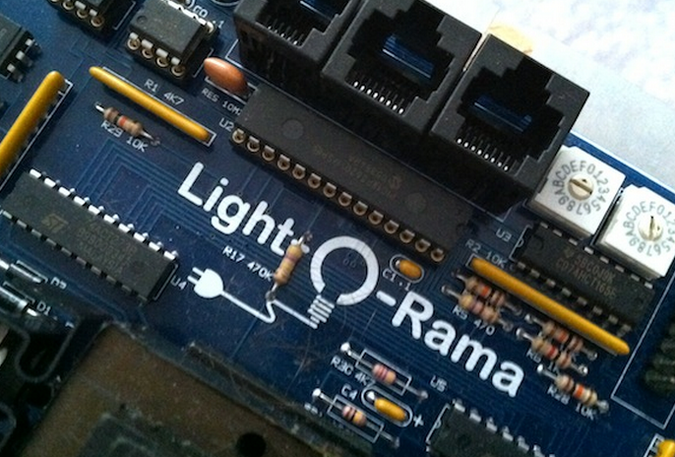
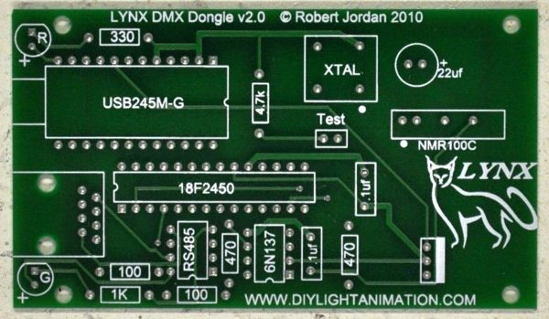
Working Together with
LOR and DIY
Matt Brown
(dowdybrown on DIYLA & DIYC)

Slide 2
Class Description
You’ve been working on your animated display for years and you have always used Light-O-Rama equipment. You love the items you have and don’t want to start over but you’re interested in getting into the DIY side of things. How can you make these two platforms work together? How can you integrate new DIY ideas and applications into your already-existing Light-O-Rama environment? If those are your thoughts you are not alone. Matt Brown, a long-time LOR user who experienced the same thing, will be showing you how to make these two platforms work together, opening up new possibilities for your display without sacrificing everything you are already using.

Slide 3
What is LOR?
LOR is light controllers
LOR is sequencing software
LOR is a protocol that the software uses to speak to the hardware

Slide 4
So How Do You Want To
Branch Out?
Do you want to integrate different controllers with new capabilities?
  New controllers will mean supporting a protocol other than LOR
Do you want to use capabilities of other software in your sequences?
Do you want to switch from the LOR protocol to DMX (or E1.31) so that you are ready to make additional changes next year?

Slide 5
Warning!
16
Channels
10,000
Channels
Do NOT change too many things at once
If things go wrong, it becomes very difficult to isolate the source of the problem
Change one thing, then test it to make sure it is working the way you want. Then you can make another change.

Slide 6
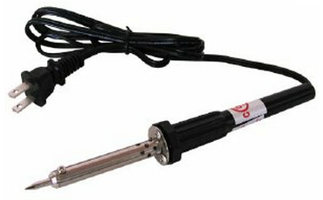
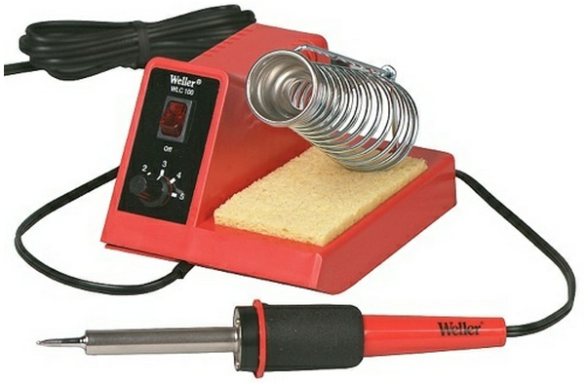
Soldering
Whether it is soldering together a kit or just building a custom cable, soldering is an essential skill for any DIY’er
Take advantage of the soldering classes and soldering lab here at the academy. Take home a new skill!

Slide 7
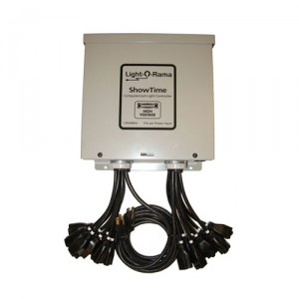
Communication Protocols
A protocol is the language the software uses to talk to the controllers
Hey, unit 6, circuit 3, ramp from 0% to 100%
Dongle
Lighting Network

Slide 8
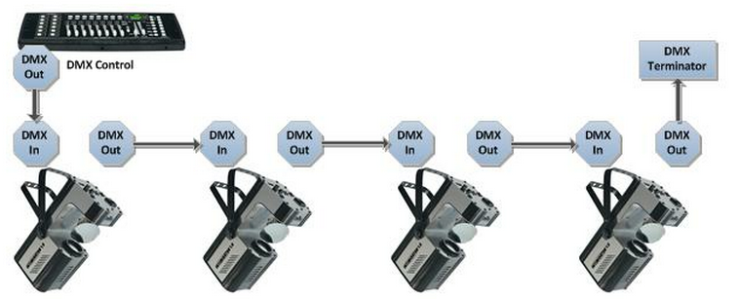
Common Christmas Lighting Protocols
LOR
DMX
Renard
PixelNet
E1.31 (aka SACN)
  “DMX over Ethernet”
  Can also transport other protocols
    Lynx Etherdongle can output DMX or Pixelnet
    J1sys devices can also output renard
    New LOR device will output DMX or LOR

Slide 9
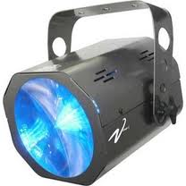
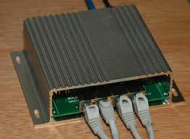
Integration, Approach #1
Some software can speak more than one protocol
One way to integrate is to have a separate dongle for each type of controller
LOR Dongle
LOR Network
DMX Dongle
DMX Network
Ethernet
DMX Devices
LOR Devices
E1.31 Devices

Slide 10
Protocol Support
 | LOR | DMX | Renard | PixelNet | E1.31
LOR S2 | 
LOR S3 |  |  |  |  | soon
LSP |  |  |  |  | 
xLights |  |  |  |  | 
Vixen |  |  |  |  | 
HLS |  |  | 
xLights does scheduling only. All others can do sequencing & scheduling.

Slide 11
LOR DMX
Did you know that most LOR controllers are “bi-lingual”? They understand both the LOR protocol and the DMX protocol. This includes the CCR.
LOR
or
DMX

Slide 12
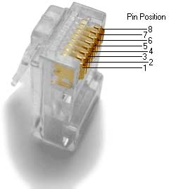
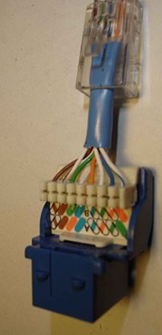
LOR DMX http://www.diylightanimation.com/wiki/index.php?title=Light-O-Rama_Controllers
8-pin connectors (RJ45) on LOR controllers expect data on pins 4 & 5
RJ45 connectors on DIY equipment expect data on pins 1 & 2
It is possible to use both controllers on the same DMX network, as long as you have an adapter that swaps the pins when going from one controller type to the other.
DMX Dongle | LOR | Signal
WHT/OR (1) | BLUE (4) | D+ (A)
ORANGE (2) | WHT/BLUE (5) | D- (B)
BRN/WHT (7) | GRN (6) | D1 Ret (Gnd)
NC!! | GRN/WHT (3) | +9V

Slide 13
Integration, Approach #2
Run everything using the DMX protocol
DMX Dongle
DMX Network
DMX Devices
DMX
DMX
Wiring adapter
(12<>45)
LOR Devices

Slide 14
Why Switch to DMX?
There are several technical reasons why the DMX protocol is better. However, the bottom line is this:
  The LOR protocol will run up to about 500 channels (per dongle) of traditional light strings with minimal issues.
  If you want to control RGB lights or theatre lights or dance club lights or use DIY controllers, then you should switch to DMX.

Slide 15
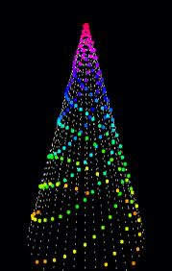
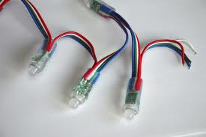
Lynx Smart Strings
RGB lights where each node can be set to any color
Requires PixelNet protocol
More info at: http://diylightanimation.com
Similar capabilities can be achieved using products from:
  stellascapes (controllers & lights)
  SanDevices (controllers only)

Slide 16
PixelNet Integration
A PixelNet universe consists of 4096 channels
The PixelNet 16 Port Active Hub has a feature where 512 of the 4096 channels can be output as DMX

Slide 17
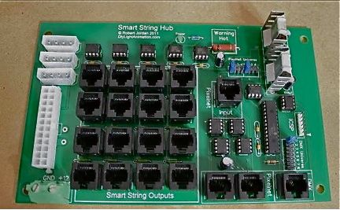

PixelNet Integration
Start with PixelNet, but use the DMX output on the hub
Lynx EtherDongle (E1.31)
Ethernet
PixelNet
PixelNet Dongle
PixelNet
DMX
SmartString Controllers
Wiring adapter
(12<>45)
DMX
DMX
DMX Devices
LOR Devices

Slide 18
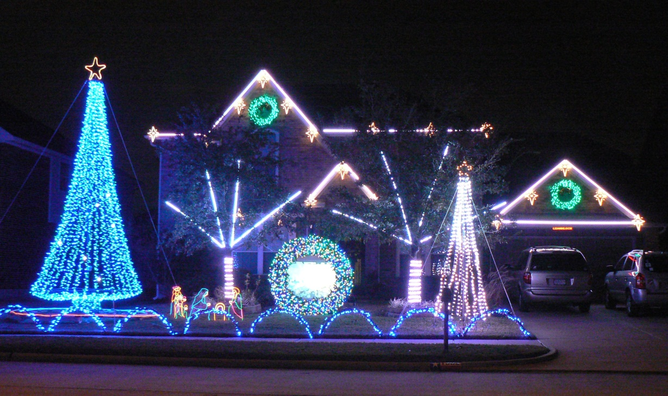
LOR and DIY Playing Together
Megatree on the right uses 1800 channels of PixelNet
4 LOR controllers
6 Lynx Express controllers
8 Lynx DC controllers
Sequenced with LOR S3
Scheduled with xLights

Slide 19
2011 Controller Connections
Pixelnet
Dongle
Smartstring
Hub
LE1
DC6 BRL
DC2 BRU
DC5 BLL
DC1 BLU
PN 2049
-2560
DMX 1-16
DMX 257-272
DMX 193-208
DMX 241-256
DMX 177-192
PN 1-1800
LOR3-4
LOR5-6
Wireless
DMX 33-64
DMX 65-96
Term
Wireless
LE4 SR
DC4 SRU
DC8 SRL
DMX 113-128
DMX 225-240
Term
DMX 289-304
Wireless
LE3 SL
DC3 SLU
DC7 SLL
LE2
DMX 97-112
DMX 209-224
DMX 273-288
Term
DMX 17-32
DMX
Dongle
LE5
TP3244
TP3244
DMX 1-16
DMX 401-502
Term
DMX 17-400
DMX
Dongle
LE6
TP3244
DMX 1-16
Term
DMX 17-340

Slide 20
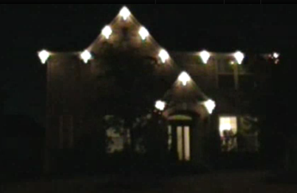
You CAN Do This!
My Display History
  2007: 16 channels (1 LOR Controller)
  2008: 64 channels (4 LOR Controllers)
    Train
    10 ft megatree
  2009: 96 channels (6 LOR Controllers)
    Video Wreath
    Megatree grew to 20 ft
  2010: 1034 channels
    First RGB
    First DIY Controllers
  2011: 2800+ channels
    First SmartStrings
    First RGB Megatree
2007: 16 channels

Slide 21
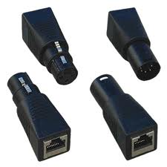
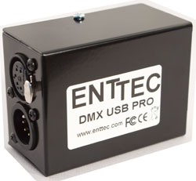
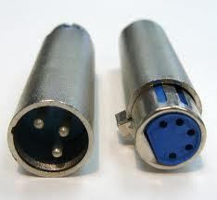
Getting Started
Sources For DMX Dongles
Entec USB Pro (the original) – 5 pin
Lynx Dongle (DIYLA) – RJ45
RPM Dongle (DIYC) – RJ45
DMXKing.COM – 3 & 5 pin

Slide 22

Getting Started
Equipment & Information
http://diylightanimation.com/
  Forums
  Wiki

